Slide 2
Overview
A flat foot is a very common problem among the population.
May cause back problems, knee, and even disability
People do not test for flat foot as part of routine checks and can go a lifetime without diagnose
Therefore, we find it important to create an application who could give quick platform to check for flat foot.

Slide 3
Goals
Created a simple and convenient application that can recognize the problem of the flat foot .
If flat foot detected, the application will recommend appropriate shoes, as a first treatment.

Slide 4
Users
First type:
Users who want to know, whether they have flat foot or not.
Second type:
Like the first type but also want to get recommendation on appropriate shoes according to their diagnosis.

Slide 6
How does it work

Slide 7
Technologies
Azure Machine learning
Azure database
Azure Blob storage
Azure cloud computing
Afroge .NET for image processing
Dependencies
Camera access
Internet access

Slide 8
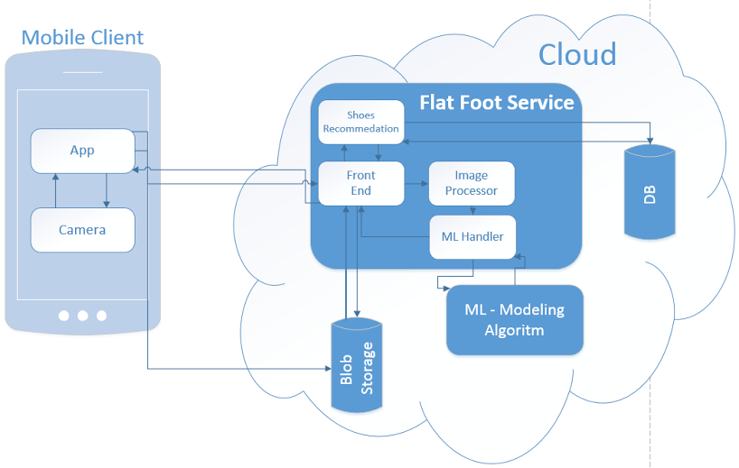
Logical Architecture

Slide 9
Flow

Slide 10
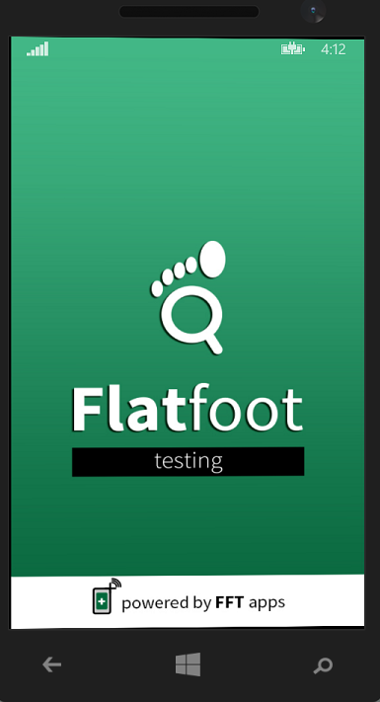
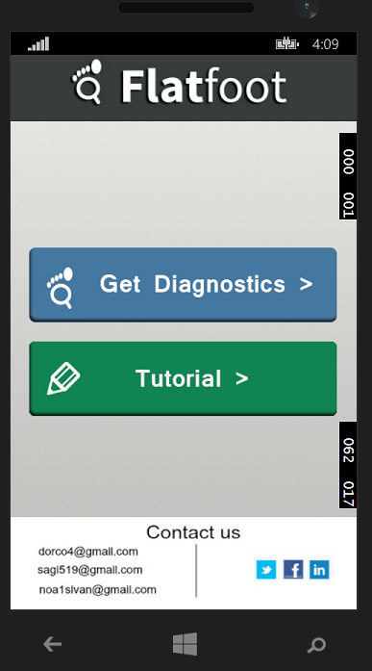
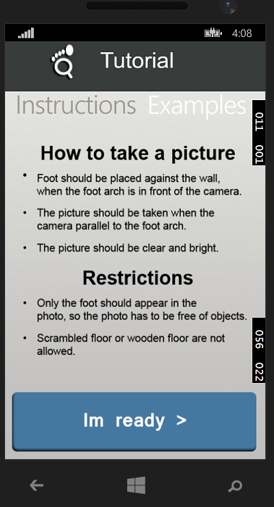
Screens

Slide 11
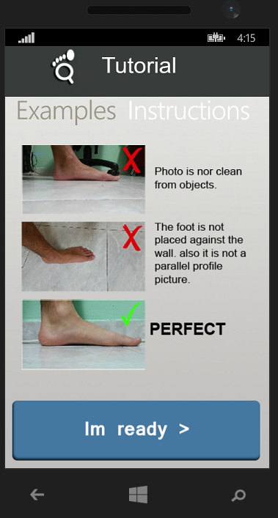
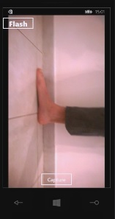
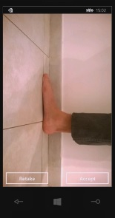
Screens – continue

Slide 12
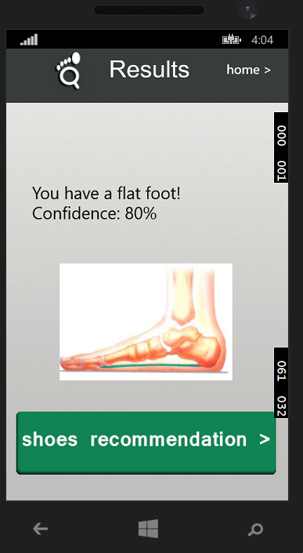
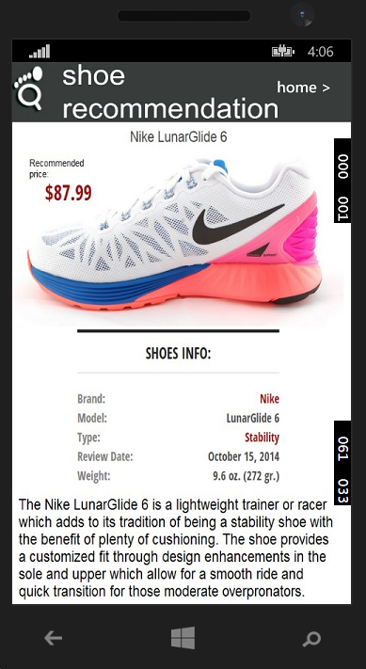
Screens – continue

Slide 13
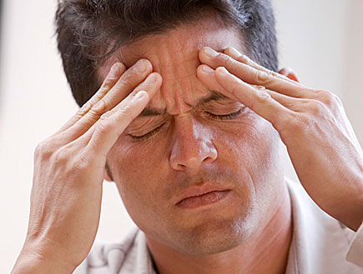
Difficulties
Where to begin?
How to recognize flat foot.
How image processing works(no information about feet at all).
Learning machine learning.
How many, and which parameters do we need to extract from the foot image

Slide 14
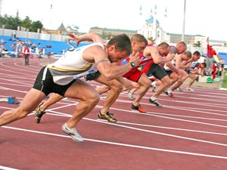
Difficulties
Getting started
How to extract the height and the length of the foot arch(lack of foot image processing).
Achieving enough images to add to the ML database.
Database row size is smaller then we needed.

Slide 15
Some more difficulties
Sending the image to the server
Sending image to the server using JSON, not always works.
How to use the BLOB storage.
Dealing with slow uploading speed.
How to use threads and distribution of the image to smaller chunks, to achieve faster upload.

Slide 16
And many, many more difficulties...
Unsupported modules in Microsoft 8.1.
Working with camera – only front camera works, low resolution, retaking a picture.
Back button crashes
Designing the app.

Slide 17
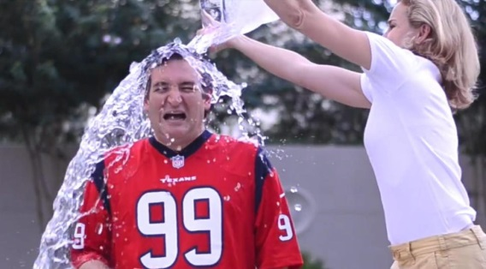
Challenges
difficulty in explaining users how to take the picture right.
In order that the app will be widely used, we need high percentages of successful labeling.

Slide 18
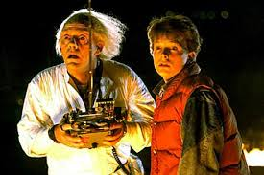
In the future
Support high arch detection
Support foot pronation detection
Appropriate specialist referral, depending on the diagnose
Support other platforms(android,ios)

